Slide 1
NoSQL Data Integration Survey

Slide 2
NoSQL Data Integration Survey
Solutions specifically designed for the integration of heterogeneous NoSQL systems.
Solutions focused on improving/adding features of existing key-value stores or other NoSQL systems.
Solutions focused on the integration of NoSQL and SQL systems.

Slide 3
Papers surveyed
Materializing SQL Queries in Key-Value Stores [Unknown]. SIGMOD 2014 {1}
A. Dey, A. Fekete, U. Rohm [U of Sydney]. Scalable Transactions across Heterogeneous NoSQL Key-Value Data Stores : VLDB 2013 {2}
D. J. DeWitt & al, Split Query Processing in Polybase [Microsoft] {3}
D. Abadi & al, Efficient Processing of Data Warehousing Queries in a Split Execution Environment [Hadapt, Yale] {4}

Slide 4
Topics
SQL-NoSQL integration in the context of data warehousing {3},{4}
Transactions, OLTP and ACID {2}
Materialized Views in NoSQL {1}

Slide 5
Split Query Processing in Polybase [David J. DeWitt, A. Halverson, R. Nehme, S. Shankar, J. Aguilar-Saborit, A. Avanes, M. Flasza, J. Gramling, Microsoft]
Polybase : feature of SQL Server PDW that allows to simultaneously query structured relational data (SQL Server) and unstructured data (HDFS) on a Hadoop cluster.
Uses the split query processing paradigm (introduced by Hadapt).

Slide 6
Split Query Processing in Polybase [David J. DeWitt, A. Halverson, R. Nehme, S. Shankar, J. Aguilar-Saborit, A. Avanes, M. Flasza, J. Gramling, Microsoft]
Polybase Use Cases (query accessing simultaneously structured and unstructured data):
a) Query submitted requires reading data from HDFS.
b) Query submitted requiring writing data to the HDFS.
Queries that do a) and b) are possible.
Unstructured data stored by HDFS is represented by external tables in PDW.

Slide 7
Split Query Processing in Polybase [David J. DeWitt, A. Halverson, R. Nehme, S. Shankar, J. Aguilar-Saborit, A. Avanes, M. Flasza, J. Gramling, Microsoft]
Architecture
Architecture of Polybase:
SQL Server PDW and Hadoop are used in parallel.
HDFS data is seen as an external table by SQL Server PDW.
Communication between the two systems is done through the HDFS bridge.
Reading from Hadoop as a PDW external table.
PDW Engine requires information about about corresponding HDFS file to the name node of the Hadoop cluster.
Location of the partitions of the file across the Hadoop are sent to the compute nodes.
Compute Nodes access Hadoop data nodes where the file is located directly.
Writing to HDFS is done in a similar manner.
DMS stands for Data Moving Service.

Slide 8
Split Query Processing in Polybase [David J. DeWitt, A. Halverson, R. Nehme, S. Shankar, J. Aguilar-Saborit, A. Avanes, M. Flasza, J. Gramling, Microsoft]
Query Optimization
Polybase uses a cost-based query optimizer to determin when it is advantageous to push SQL opration on HDFS resident data to the Hadoop Cluster for execution in the form of MapReduce Jobs.
As such, Polybase requires detailed statistics for external tables in HDFS as well.
Query optimization is used usingt a classical Selinger-style parallel optimizer.

Slide 9
Split Query Processing in Polybase [David J. DeWitt, A. Halverson, R. Nehme, S. Shankar, J. Aguilar-Saborit, A. Avanes, M. Flasza, J. Gramling, Microsoft]
Optimized Plans are translated into distributed SQL (DSQL) plans which consists of the following operations :
SQL Operation : SQL operators executed directly on SQL Server instances.
DMS Operation : operations for reading/writing between PDW and HDFS.
Return Operation : return to client application.
Hadoop Operation : map reduce job sent from PDW to the Hadoop cluster.

Slide 10
Split Query Processing in Polybase [David J. DeWitt, A. Halverson, R. Nehme, S. Shankar, J. Aguilar-Saborit, A. Avanes, M. Flasza, J. Gramling, Microsoft]
Map Reduce Join Implementation in Polybase:
Join may access unstructured data.
Always uses distributed hash join algorithm.
Smaller input relation (build input) is always materialized into n partitions.
We create n map tasks, where each map task evaluates one of the partition of the join.
Binary join operation is converted to a unary operation by hiding the consumption of the materialized build input.

Slide 11
Efficient Processing of Data Warehousing Queries in Split Execution Environment [K. Bajda-Pawlikowski, D. Abadi, A. Silberschatz, E. Paulson @Yale,Wisconsin]
Hadapt is a Big Data Analytics platform which uses Hadoop to execute SQL queries efficiently.
Each data node in the Hadoop cluster has its own PostgreSQL database in addition to the HDFS.
The goal is to process answer SQL queries in parallel using map reduce.

Slide 12
Efficient Processing of Data Warehousing Queries in Split Execution Environment [K. Bajda-Pawlikowski, D. Abadi, A. Silberschatz, E. Paulson @Yale,Wisconsin]
Components of HadoopDB Architecture :
Database Connector
Data Loader
Catalog
Query Interface
Query execution :
Queries can be given as map reduce job where parts of the query processing (that can be performed independently) are sent to the database systems of individual nodes.
The database connector allows each node to access relational databases located on other nodes if necessary.

Slide 13
Polybase vs Hadapt
Polybase's interface is the PDW product microsoft is selling. Hadoop is viewed as a secondary data source. Hadoop data has to be "registered" with the database through an external table mechanism. As such, the hadoop data must be somewhat structured (it cannot be truly arbitrary given the schema constraints imposed by the external table). Moreover, if we look at a plot of the query time and where it is spent, the vast majority of the time is spent on import data from Hadoop to SQL PDW. In other words, it would have been better to have kept the data in PDW all along.

Slide 14
Polybase vs Hadapt
In Hadapt, if the data is structured enough to fit in the DBMS, we only pay a one time load cost. Subsequent queries do not have to worry about data import ( ==> what about updates?).
The decision to have data stored in HDFS or SQL does not depend on the number of time this data is accessed, but whether that data is structured (or semistructured) or completely unstructured.

Slide 15
Polybase
As such, Polybase is better for accessing data from Hadoop when queries that access Hadoop data are unfrequent, since the Hadoop data is kept out of the database unless it is specifically required by a query.
Polybase will access Hadoop as little as possible (only if the data required for a query is in HDFS).
On the other hand, Hadapt uses map reduce for long-running queries and leverages Hadoop to get dynamic query scheduling and fault tolerance.
Hadapt will access Hadoop as soon as a query is considered long running (or cannot be solved by a single node).

Slide 16
Materializing SQL Queries in Key-Value Stores
Key-Value stores are tailored for key-based reads/writes.
Not very practical if we want a global view of the system.
How to get an online (up to date) view of the entire data efficiently (not just for a few keys)?
How do we do complex query processing in key-value stores (involving joins)?

Slide 17
Materializing SQL Queries in Key-Value Stores
Solution : implement SQL-like materialized views in key-value stores and maintain them efficiently.
Materialized Views are analogous to SQL operators :
Projection View
Index View
Selection View
Aggregation View
Join View
Hierarchical View : this type of view allows to compose the previous views.
Whenever a change is made to an original table in the key-value store, it is reflected on the views. Views cannot be updated directly (only through the base tables). The changes are propagated across views in the case of the hierarchical view.

Slide 18
Materializing SQL Queries in Key-Value Stores
How is the view stored internally?
Views are stored as tables within Cassandra nodes. However, they follow a different data model. The model itself depends on the view type. It uses the extensible record capabilities of Cassandra to perform some of the views.
Extensible record store : multiple values are allowed per key. A key can be composed of multiple attributes.

Slide 19
Materializing SQL Queries in Key-Value Stores
What is the required functionality (class of queries) for a key-value store to be compatible with the solution?
Is not specifically mentioned, but it is implied that only the typical GET(),INSERT(),DELETE(),UPDATE() operations are required.
The implementation uses the extensible record feature from Cassandra but the author claims the same system could be implemented with a single value per key.
NOTE : it seems this paper has been written by the Cassandra people.

Slide 20
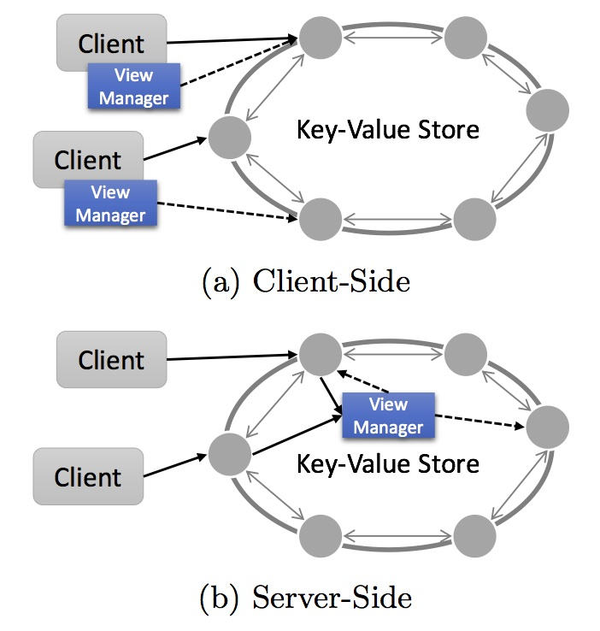
Materializing SQL Queries in Key-Value Stores
Architecture could be either client-side or server-side.
Current architecture is server-side.
Article does not specify on which server node view managers are implemented

Slide 21
Materializing SQL Queries in Key-Value Stores
Weak Consistency : state of view and base table converge eventually.
Hierarchical Views
Strong Consistency : on top of weak consistency ordering of the base table states is preserved in the view.
All other views
Complete Consistency : on top of strong consistency, all base table states are reflected in view table states.

Slide 22
Scalable Transactions across Heterogeneous NoSQL Key-Value Data Stores [A. Dey, A. Fekete, U. Rohm (U of Sydney)]
Problem : Cloud and NoSQL systems do not offer good consistency guarantees and very limited transactions capabilities. We want to give multiple-item transactions capabilities across heterogeneous NoSQL data sources.

Slide 23
Scalable Transactions across Heterogeneous NoSQL Key-Value Data Stores [A. Dey, A. Fekete, U. Rohm (U of Sydney)]
Assume the architecture on the right.
Solution 1 : Implement multi-item transaction on the client.
Prone to programmer error
Complex
Messy
Key value store

Slide 24
Scalable Transactions across Heterogeneous NoSQL Key-Value Data Stores [A. Dey, A. Fekete, U. Rohm (U of Sydney)]
Solution 2 : Implement transaction capabilities within the system.
Spanner : J.C. Corbett, J. Dean [Google]
Cops : W. Lloyd, M. J. Freedmand [Princeton, CMU]
Granole : J. Cowling, B. Liskov [MIT]
HyperDex Warp : R. Escriva, B.Wong [Cornell, Waterloo]
Problem : this is not applicable in a heterogeneous context.

Slide 25
Scalable Transactions across Heterogeneous NoSQL Key-Value Data Stores [A. Dey, A. Fekete, U. Rohm (U of Sydney)]
Solution 3 : Use a middleware system to coordinate transactions :
Google Megastore : J. Baker, C. Bondc [Google]
G-Store : S. Das, D. Agrawal [UCSB]
Deuteronomy : J. Levandoski, D.B. Lomet, K. Zhao [Minnesota, Microsoft, UCSD]
CloudTPS : W. Zhou, G.Pierre [Amsterdam]
These systems are tailored for a controlled environment of homogeneous, predictable sources.

Slide 26
Scalable Transactions across Heterogeneous NoSQL Key-Value Data Stores [A. Dey, A. Fekete, U. Rohm (U of Sydney)]
Solution : Create a transaction protocol shared by data sources and add a transaction API layer on top of each data source in a way which does not hinder the good features of cloud data stores.

Slide 27
Scalable Transactions across Heterogeneous NoSQL Key-Value Data Stores [A. Dey, A. Fekete, U. Rohm (U of Sydney)]
Protocol Key-Value Data Store requirements :
Single item strong consistency (all reads return the most recent version of an item).
Conditional Update : (test and set)
Ability to add user-defined metadata to items, such as transaction information as well as current and former versions of the item’s data.
Support for global read access
Examples of such stores :
Windows Azure
Google Cloud Storage

Slide 28
Scalable Transactions across Heterogeneous NoSQL Key-Value Data Stores [A. Dey, A. Fekete, U. Rohm (U of Sydney)]
Architecture

Slide 29
Scalable Transactions across Heterogeneous NoSQL Key-Value Data Stores [A. Dey, A. Fekete, U. Rohm (U of Sydney)]
More detailed view of the client library

